Slide 1
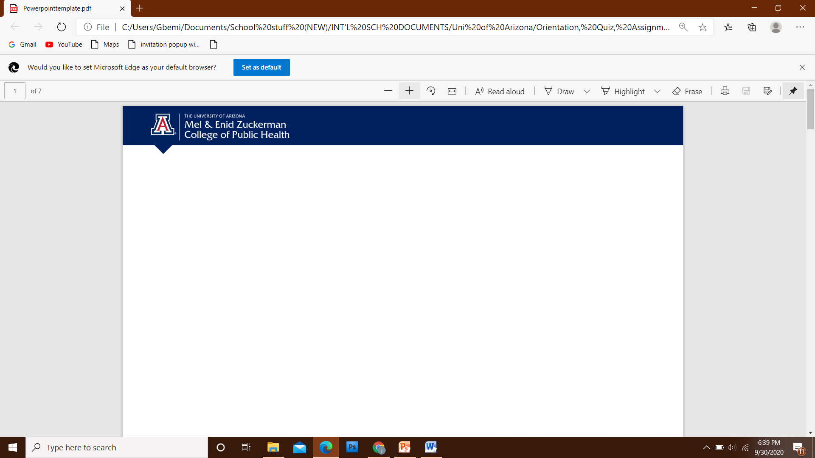
Applying Foundational Open Science Skills (FOSS) to an improved air quality data base.
(case study: Nigeria)
3rd of March 2021

Slide 2
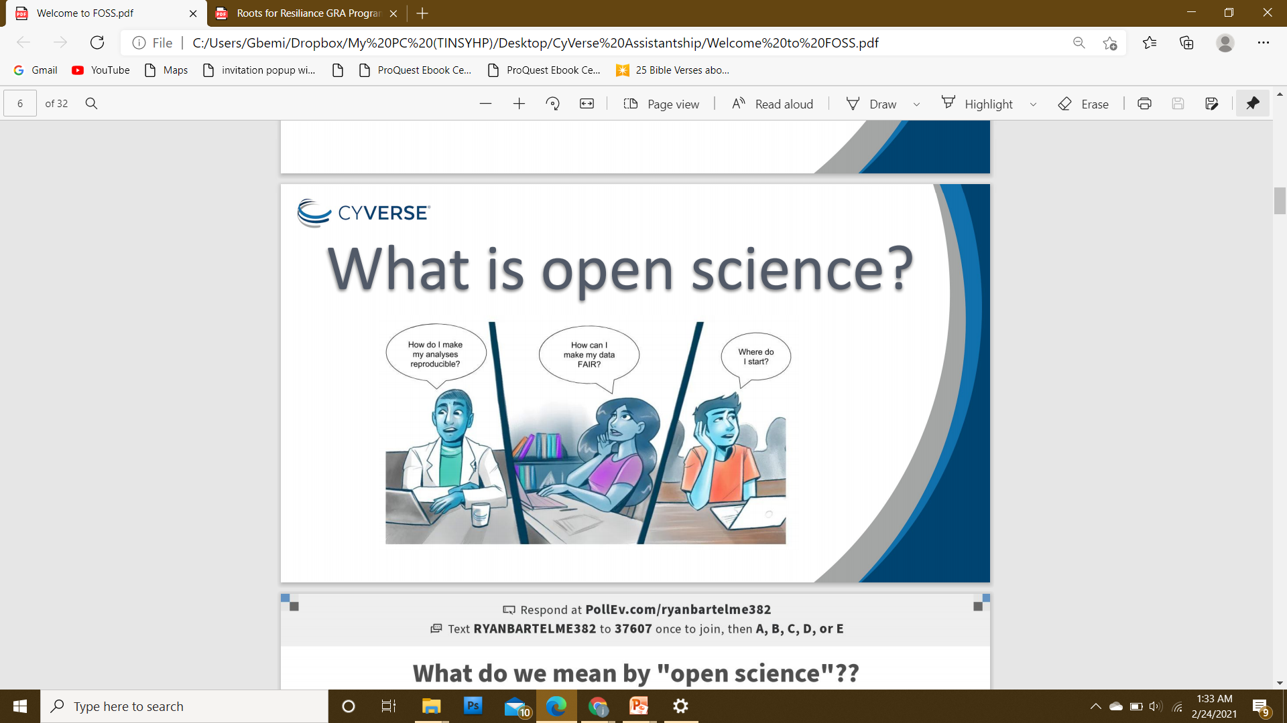
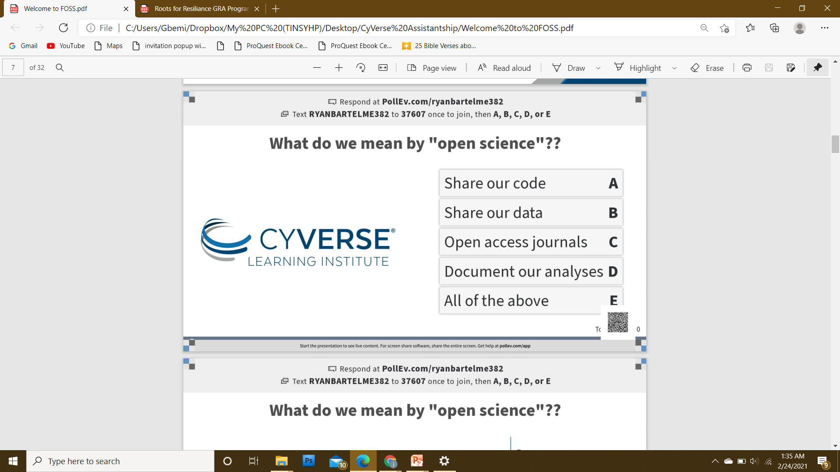
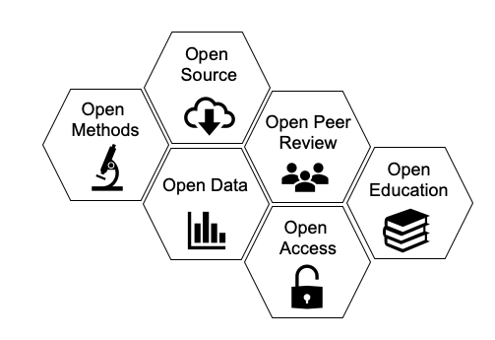
Open Science is the movement to make scientific research and data accessible to all.
CyVerse is an Open Science Workspace for Collaborative Data-driven Discovery

Slide 3


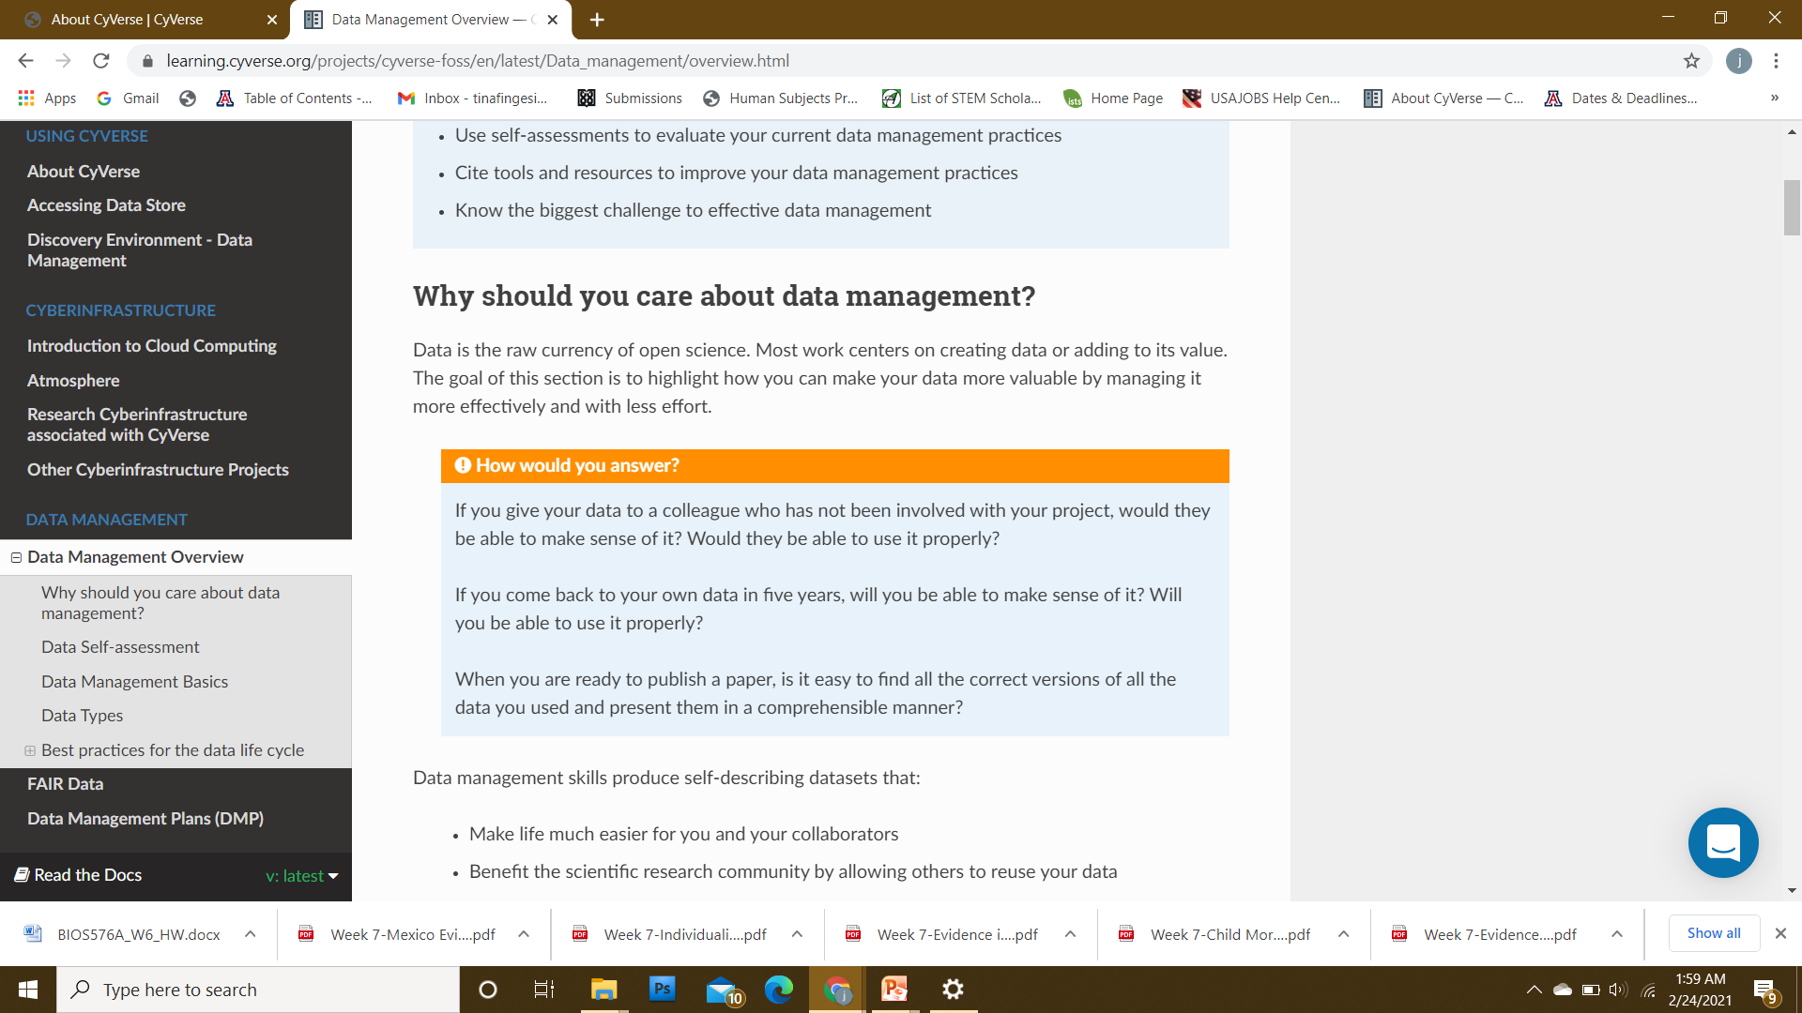

Slide 4
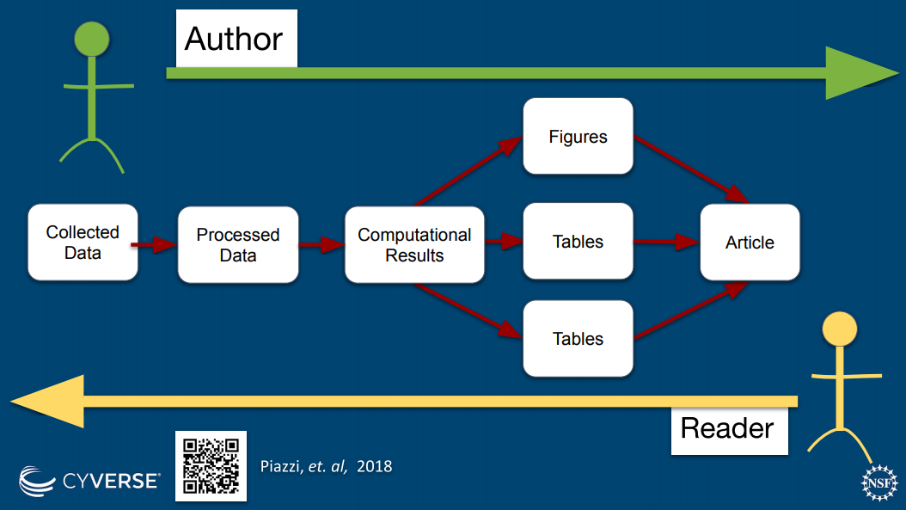

Slide 5
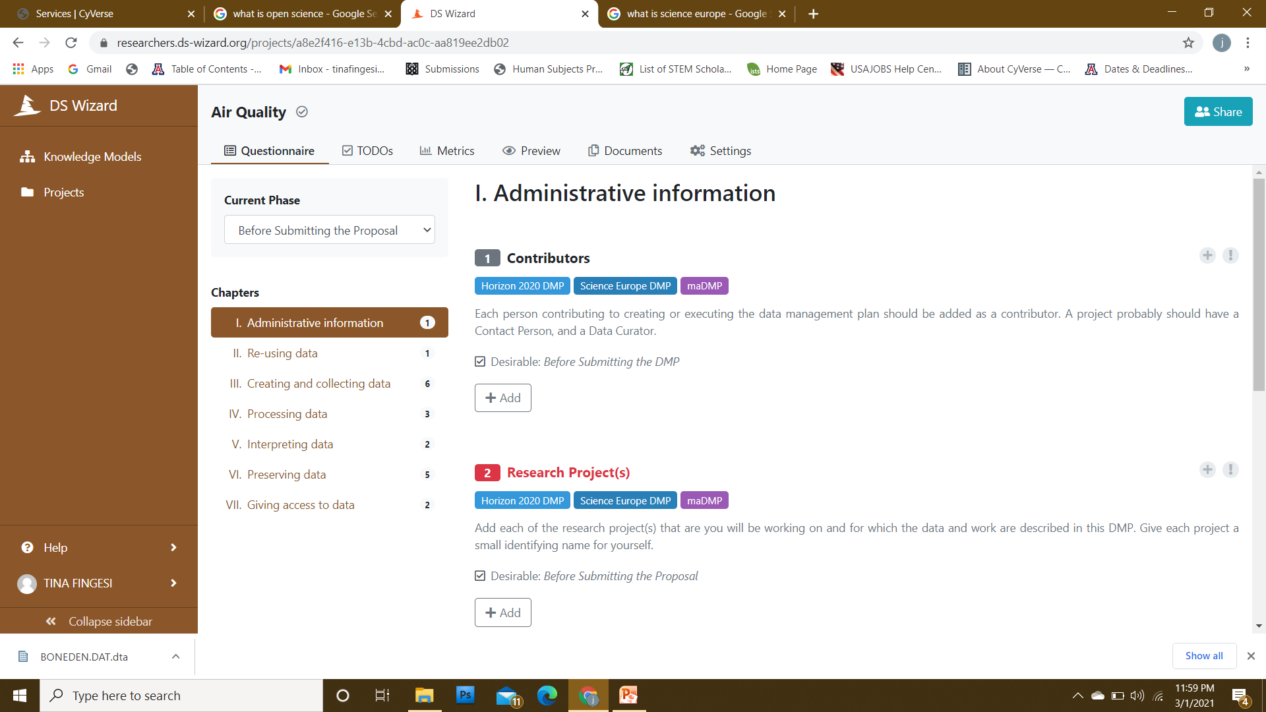
Data Management Plan (DMP)
A Data Management Plan (DMP) describes data that will be acquired or produced during research; how the data will be managed, described, and stored, what standards you will use, and how data will be handled and protected during and after the completion of the project.
Writing a DMP can be a burden, that grabs attention from the most important which is your research.
However without proper planning may be lost and cannot be reused in the future
DMP can be made easy and beneficial for research projects (Data Stewardship Wizard: https://ds-wizard.org/)
Instead of writing a lot of task, choose a template for a smart questionnaire that will guide you through the process
Research is teamwork and one can invite colleagues to collaborate online.
From the answers one can export human readable document following well known template like SCIENCE EUROPE and HORIZON 2020
Is required by most funders and many journals
Benefits the scientific research community by allowing others to reuse data
Science Europe is a research funding and research performing organization aimed to shape the future of research.

Slide 6
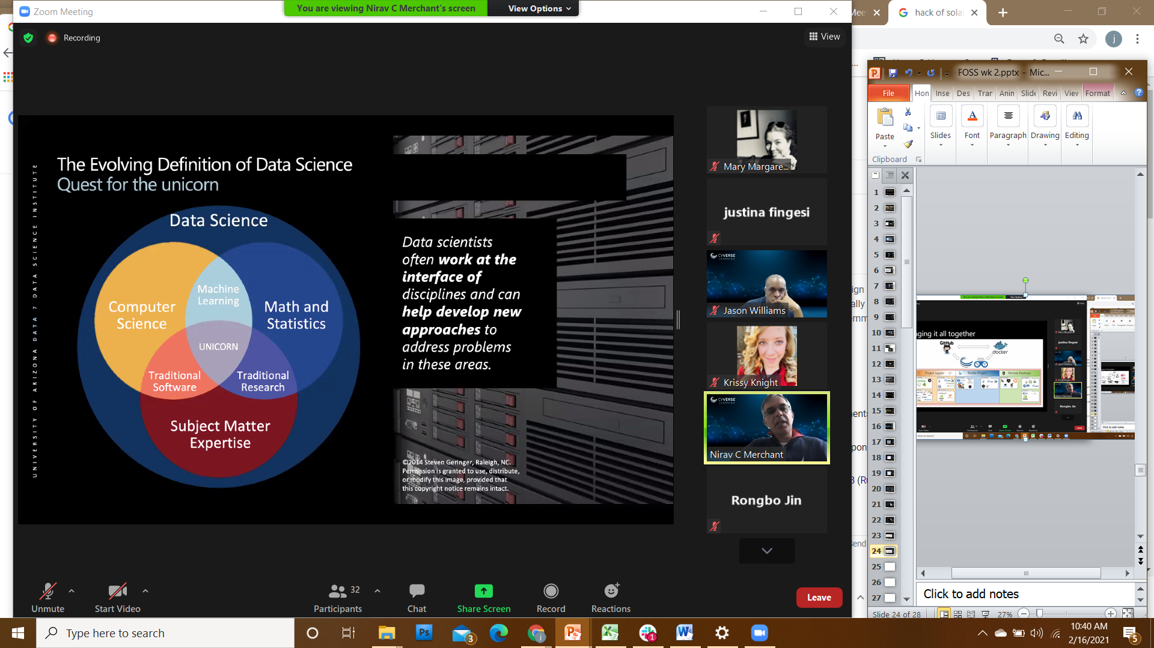
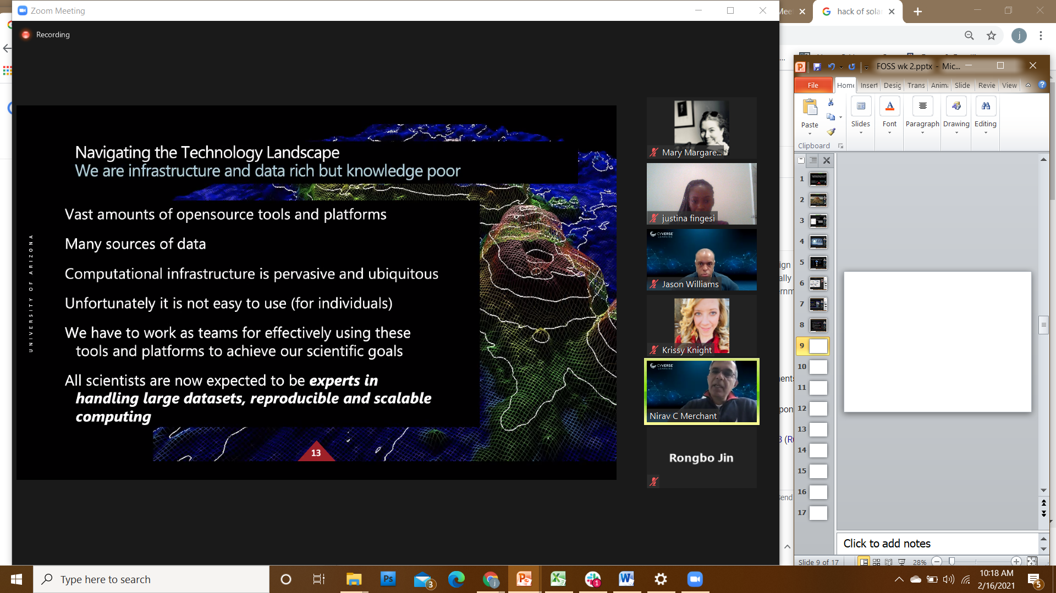
Data Release, Sharing an Management
In contrast to the popularly known GUI,
CyVerse use hundreds of CLI (analytical tools, utility tools, and scripts); without the need to learn the command line.
All software an code must be in a versioned code repository (e.g. GitHub/BitBucket) and released immediately.
Code should be well documented for others to reuse. Release of ready-to-use software and code through integration with computing resources (e.g. Galaxy, CyVerse) is strongly recommended.
In Virtual Machines (e.g. AWS, JetStream) and in Containers (e.g. Docker/DockerHub)

Slide 7
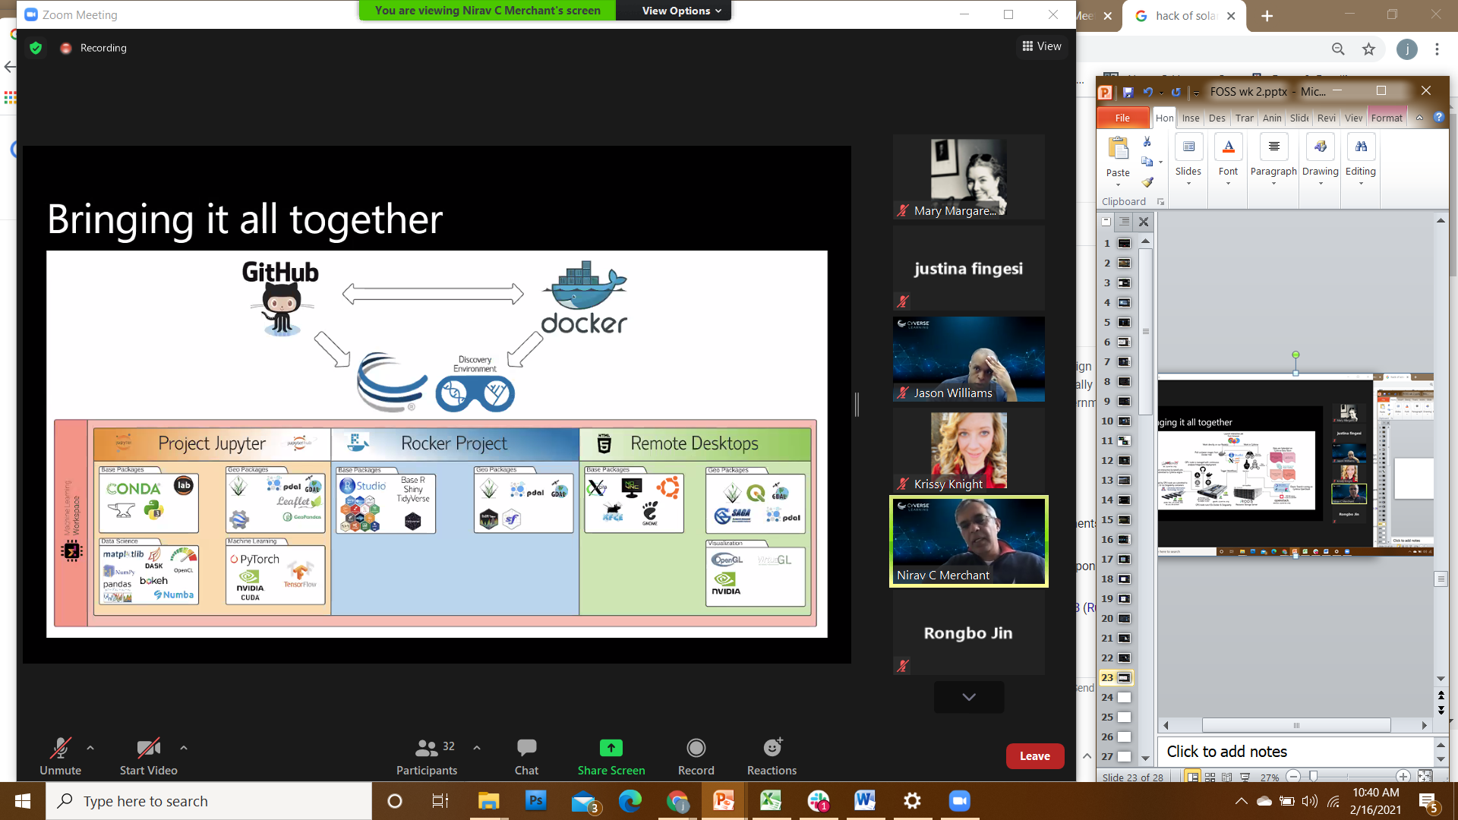
This tutorial teaches you GitHub essentials like repositories, branches, commits, and Pull Requests
GitHub is a code hosting platform for version control and collaboration. It lets you and others work together on projects from anywhere.
By completing the first four tutorials, I learned to create a project and make a pull request on GitHub! Here’s what I accomplished in this tutorial:
Repositories Created an open source repository
Branches Started and managed a new branch
Commits Changed a file and committed those changes to GitHub
Pull Requests Opened and merged a Pull Request

Slide 8
DATA SOURCES
DATA TYPES
Observational Captured in real-time, typically outside the lab Examples: Sensor readings, telemetry, survey results, images Experimental Typically generated in the lab or under controlled conditions Examples: gene sequences, chromatograms, magnetic field readings Simulation Machine generated from test models Examples: climate models, economic models Derived / Compiled Generated from existing datasets Examples: text and data mining, compiled database, 3D models
Text: Field or laboratory notes, survey responses
Numeric: tables, counts, measurements
Audiovisual: images, sound, video
Models: computer code
Discipline-specific: FASTA in biology, FITS in astronomy, CIF in chemistry
Instrument-specific: equipment outputs
Usually irreplaceable and therefore the most important to safeguard
Often reproducible, but can be expensive or time-consuming
text-based format for representing either nucleotide sequences or peptide sequences
Likely to be reproducible if the model and inputs are preserved
data format most widely used within astronomy for transporting, analyzing, and archiving scientific data files
Crystallographic Information File (CIF) is a standard text file format for representing crystallographic information
Reproducible, but can be very expensive and time-consuming

Slide 9
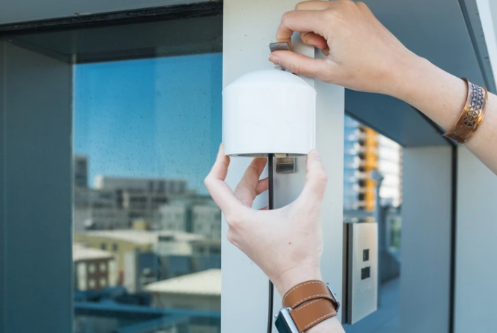
Laser pollution sensors by PurpleAir use laser particle counters that provide an accurate and low-cost way to measure smoke, dust, and other particulate air pollution.
WHY PURPLE AIR:
Using a new generation of laser particle counters to provide real-time measurement of PM1.0, PM2.5 and PM10
Real-time Air Quality Monitoring
A proven air quality monitoring solution for air quality professionals
Easy to install and only require a power outlet and WiFi to report in real time to the PurpleAir map.
Air quality sensor with both internal storage and data-transmitting abilities.
Source: purpleair.com

Slide 10
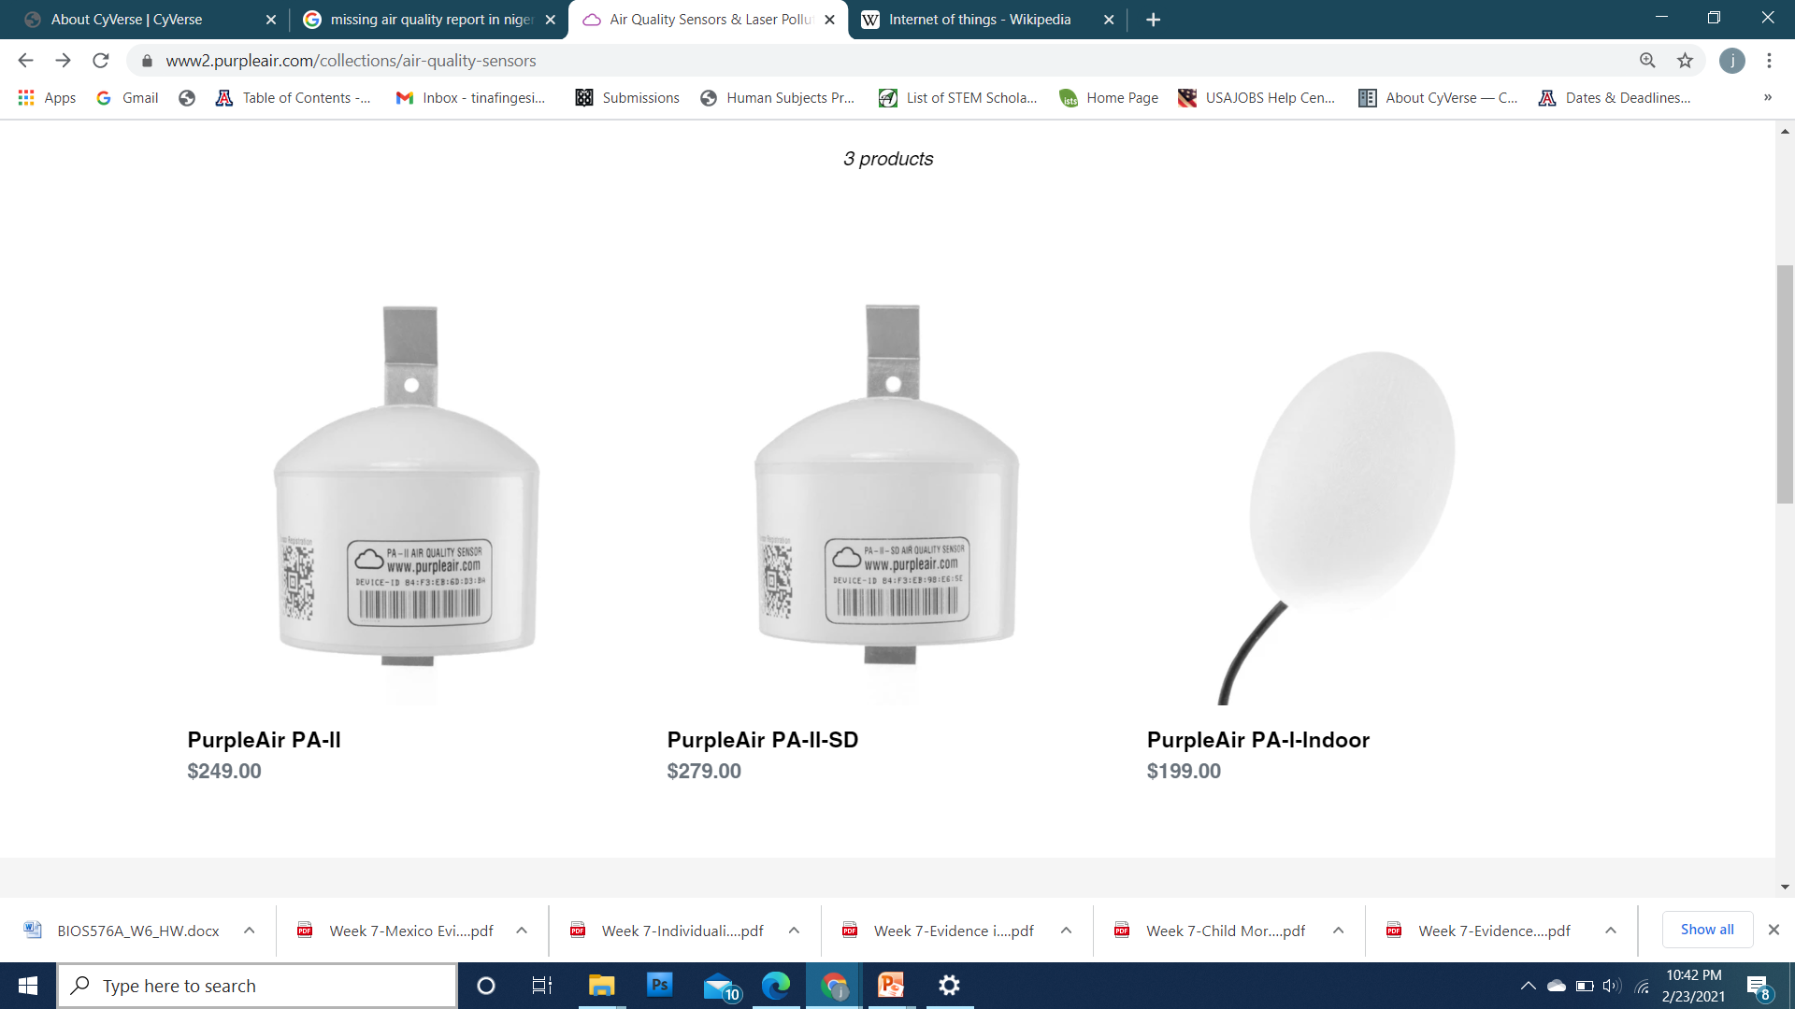


HOW IT WORKS: Air quality monitoring network built on a new generation of "Internet of Things" sensors
PMS5003 and PMS1003 sensors come factory calibrated. (Laser particle counters that count suspended particles in sizes)
PMS5003 and PMS1003
Particle counts are processed by the sensor using a complex algorithm to calculate the PM1.0, PM2.5, and PM10 mass concentration in ug/m3 and report every 120seconds..
ESP8266 and Arduino (low-cost Wi-Fi chip):
Connecting to a WiFi network and uploading data to the cloud. This ESP8266 chip runs code developed using Arduino.
PurpleAir firmware has remote update features
ThingSpeak and HighCharts:
ThinkSpeak provides the cloud storage for PurpleAir sensor data.
PurpleAir uses HighCharts and data stored on ThingSpeak to create graphs on the PurpleAir map
Mapbox:
Mapbox provides the PurpleAir map interface.
BME280 Sensor:
Includes a BME280 pressure, temperature, and humidity sensor.
PurpleAir sensors use an ESP8266 chip to talk to the particle counter and provide all functionality, including.
meaning we can modify the software and the Arduino air quality sensor device will download the new version and update itself. Each Arduino air quality sensor device checks for updates from time to time
Where these are present, there will be graphs for these values. These values are provided as is and are just for interest.

Slide 11
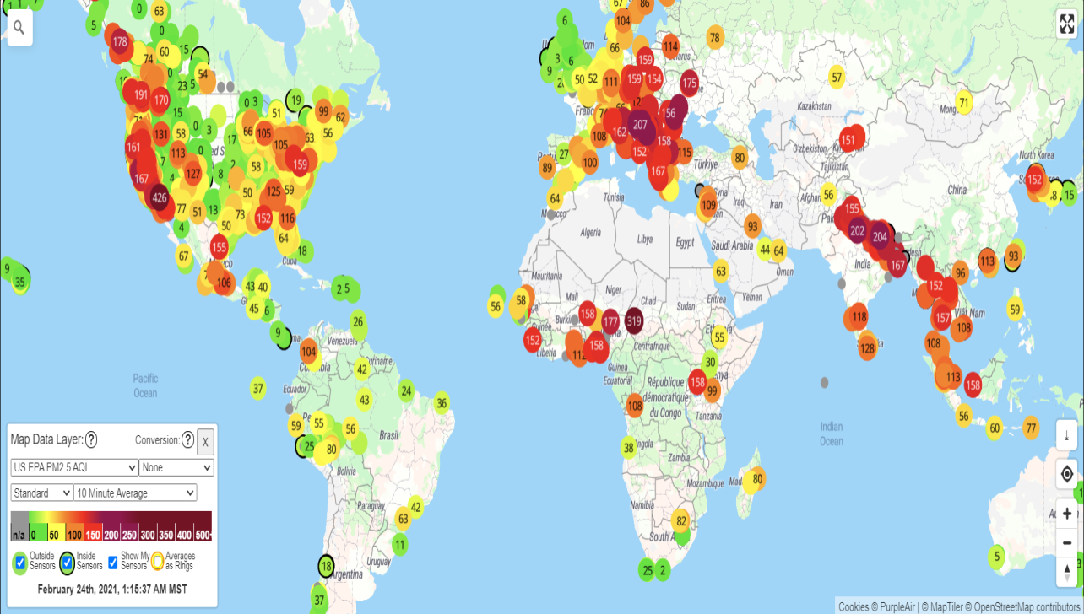
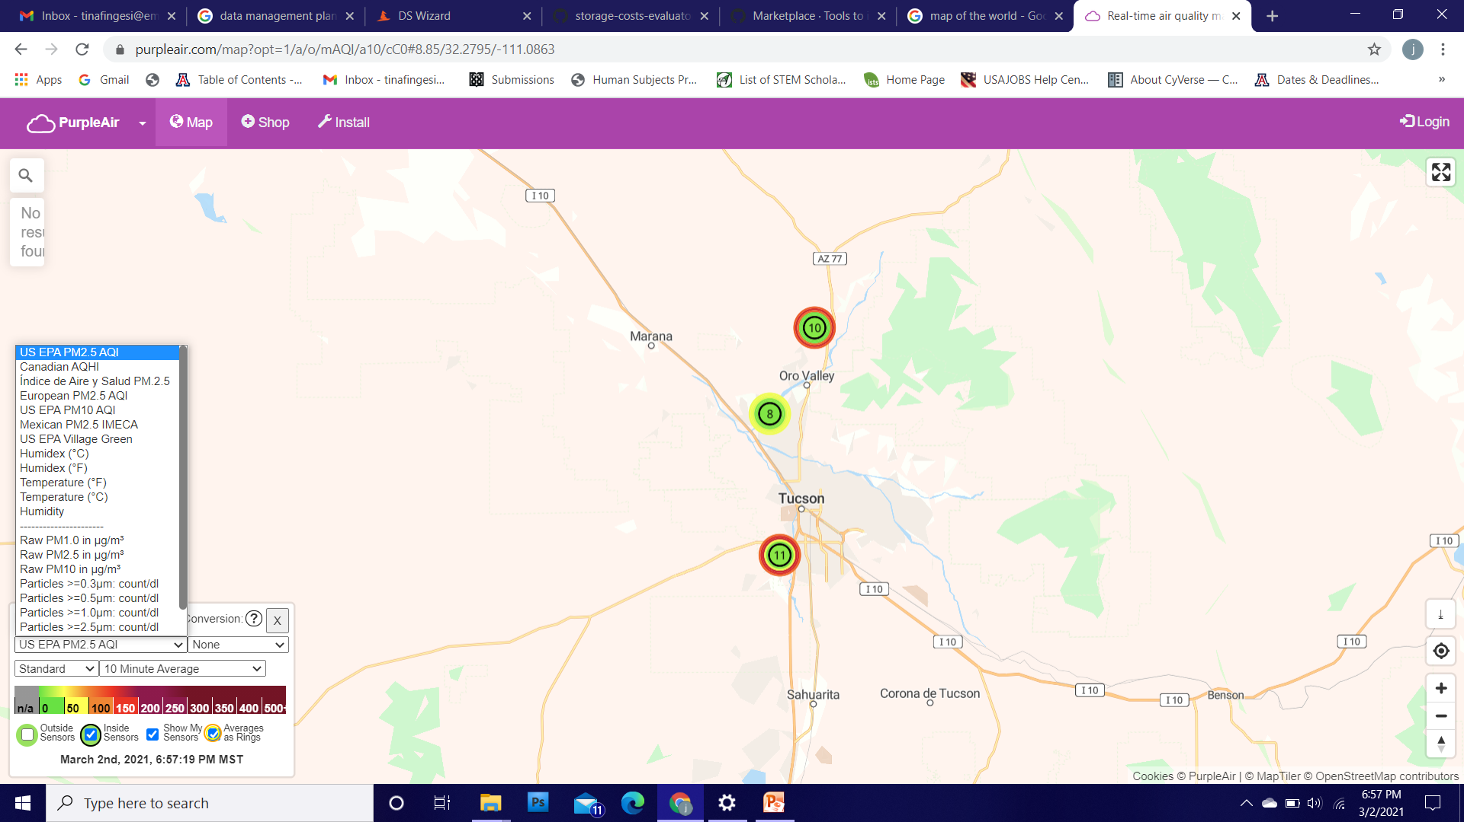
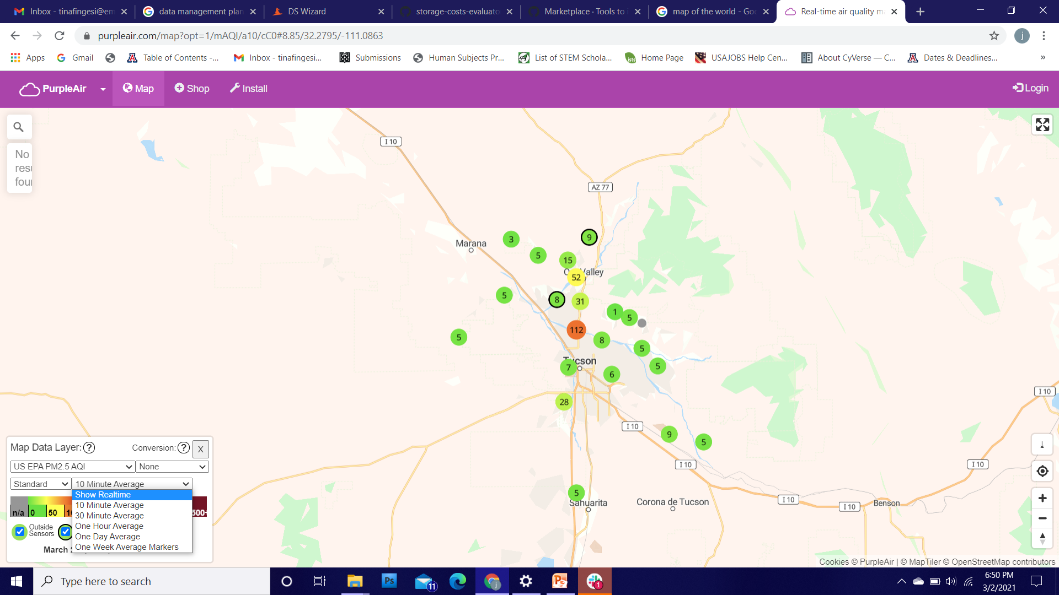
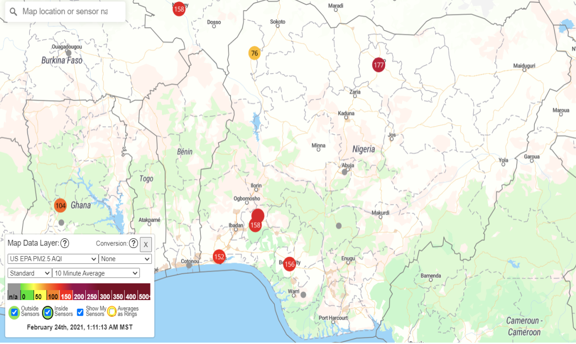
Purple Air distribution
Adapted from: https://www.purpleair.com/map

Slide 12
Purpose of Study
To promote access to real-time public air quality data that is accessible to all; thereby increasing public awareness, encouraging protective measures, and driving action to combat emissions.
Objectives
To create a data management plan and having a central place to store data and analyses
To install purple air sensors in study area and present real time ambient levels of PM_{2.5}, and PM₁₀ in study region.
To work with aggregated data in determining hourly/daily average of PM_{2.5}, and PM₁₀.
To apply FAIR principles in the analysis of collected data so that it is transparent and reproducible.
To map out air pollution hotspots in selected communities.
Study Area:
Niger-Delta and South-Western region of Nigeria
Study design
This study will adopt comparative cross sectional design.
Sampling period:
6months to 1year

Slide 13
Storing air quality data with Purple air (First trial: 6months)

Slide 14
Next research questions/Next line of action.
Stability of data considering power and internet in rural areas
Real time low cost sensors for other parameters (SO2, CO etc)

Slide 15
Thank you for listening

